Slide 1
Exploring GenAI Fundamentals
ChatGPT vs ClaudeAI

Slide 2
Generative AI
Generating new content
Learning probability distribution
Variety and novelty
Applications
Challenges

Slide 3
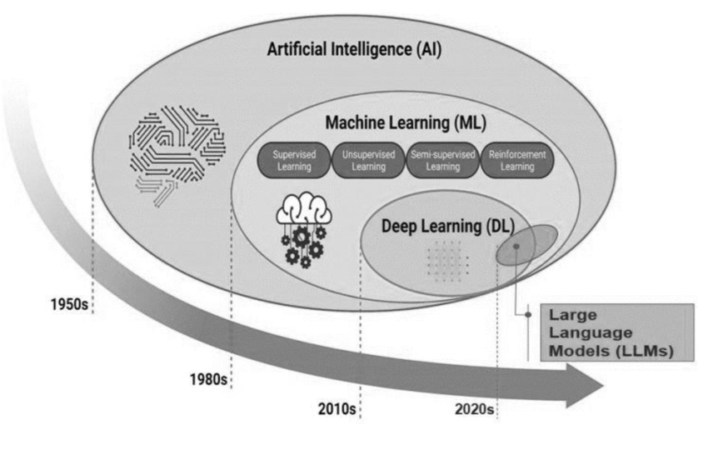
Evolution Of GenAI
Statistical ML (Simple Features)
Neural Networks
(Complex Features)
RNN
(Language
Translation)
Language Model
(Transformers)
Credit

Slide 4
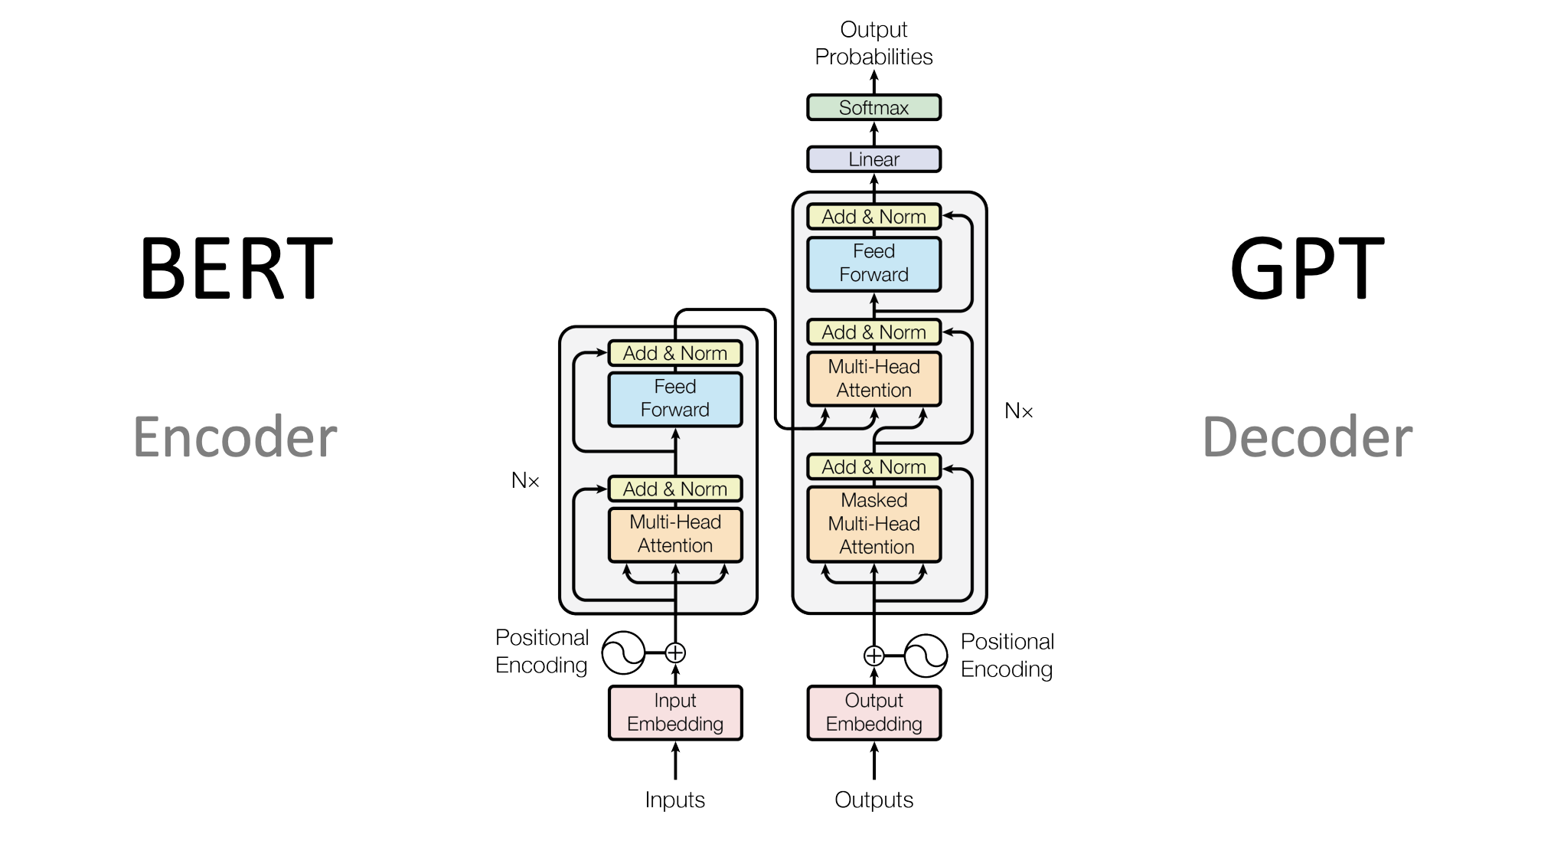
Transformers
Text-Text Models
(BERT and GPT)
Text-Image Models
(DALL-E and Stable Diffusion)
Text-Video Models
(OpenAI Sora)
Reference: Attention is all you need

Slide 5
Semantic Search
Contextual Significance via embeddings and vector databases
Embeddings -> Numerical representation of word
King - man + woman = Queen
Vector Databases -> Efficiently store and query vector representations
It calculates the similarity score between query vector and the stored vectors
Faster execution to identify similar vectors
Optimized storage

Slide 6
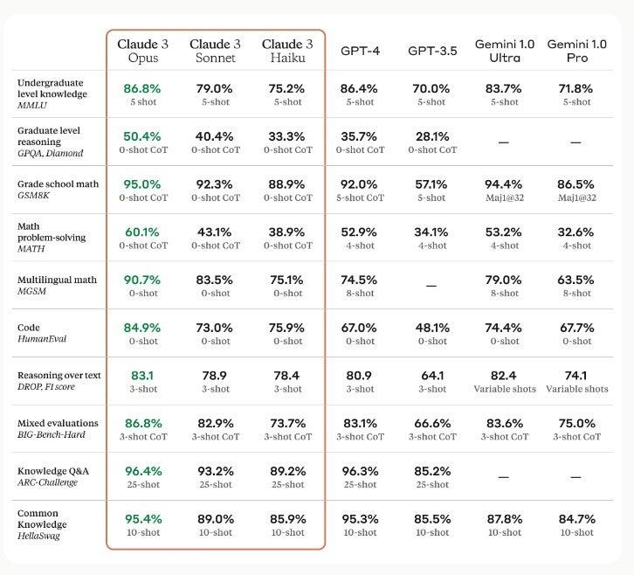
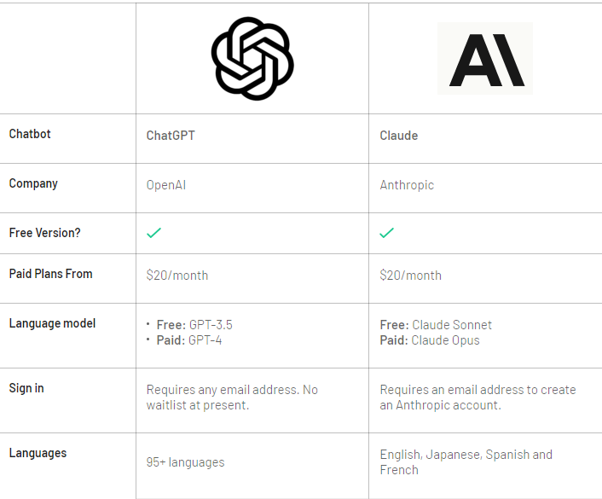
ChatGPT vs ClaudeAI
Reference

Slide 7
Thank you

